Slide 1



University Application
Submitted By : Abhaya Rawal

Slide 2

Key Highlights
Introduction
Aims & Objectives
Mission Statement
Review of Technologies
Methodology
Design
Manuals
Evaluations
Conclusion

Slide 3
Introduction
Internet based services for Universities can ease the way to a better life. Having access to class communication at any time is very necessary and beneficial.
My solution is to create an Android application that allows students to communicate with teachers and classmates for study or help.
The University Application is a mobile-based system that authenticates and identifies students and teachers, facilitates access to information and services of primary relevance and interest to users.

Slide 4
Aim of my project The project attempts to promote contact between the institution and their students via the internet and technologies.
Objectives :
Identify and develop a system to reduce student-university contact.
Identify the various needs of students and use this opportunity to learn more about the university.
Solving problems that arise in the course of product creation.

Slide 5
Mission Statement
The system is designed to be used by all university students. It can be for a little objective like asking a classmate for notes or for a larger aim like university socializing. Because most students are teenagers, making the student portal a social networking app will monitor more people.
Authentication of students and teacher
Storing records of teachers and students.
Teachers’ reviews provided by the students
Broadcasting notice and events through the university application.
Viewing classroom schedule.
Chatting with classmates and teachers.
Key features

Slide 6
Review of Technologies
Android studio
Android Studio is the official IDE for Android app development. It uses IntelliJ IDEA, a Java integrated development environment, for code editing and developer tools.
- It provides support for android application development and has multiple features.
- In order to test my application's correctness and functioning across numerous Android APIs and devices, I use an emulator.
- It has easy debugging options that help developers when an error occurs.
Firebase
Google created Firebase to help developers build, manage, and grow apps quickly.
Firebase Realtime Database
Authentication
Cloud Storage

Slide 7
Methodology
Software development methodology describes the steps taken to complete a project that facilitates software development.
Waterfall Methodology
The waterfall technique is a progressive project management approach that gathers stakeholder and customer requirements at the start of the project.
Agile methodology
Agile software development reflects the values and concepts expressed in the software development manifesto.

Slide 8

Design
Entity-Relationship Diagram
Data flow Diagram
Use case Diagram
Activity Diagram

Slide 9
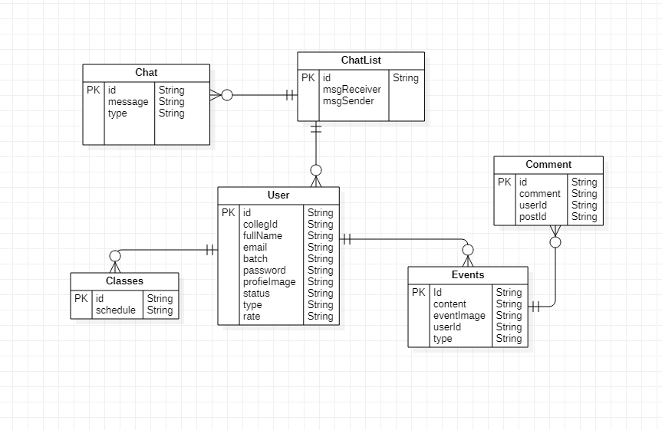
Entity-Relationship Diagram

Slide 10
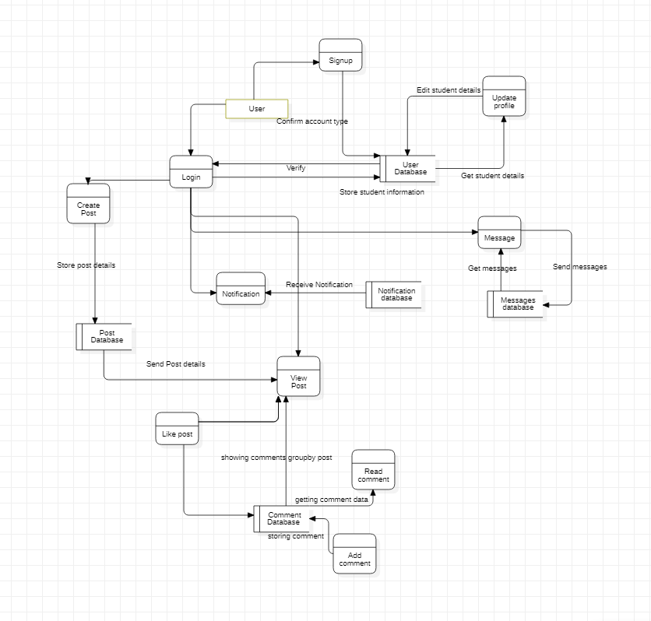
Data Flow Diagram

Slide 11
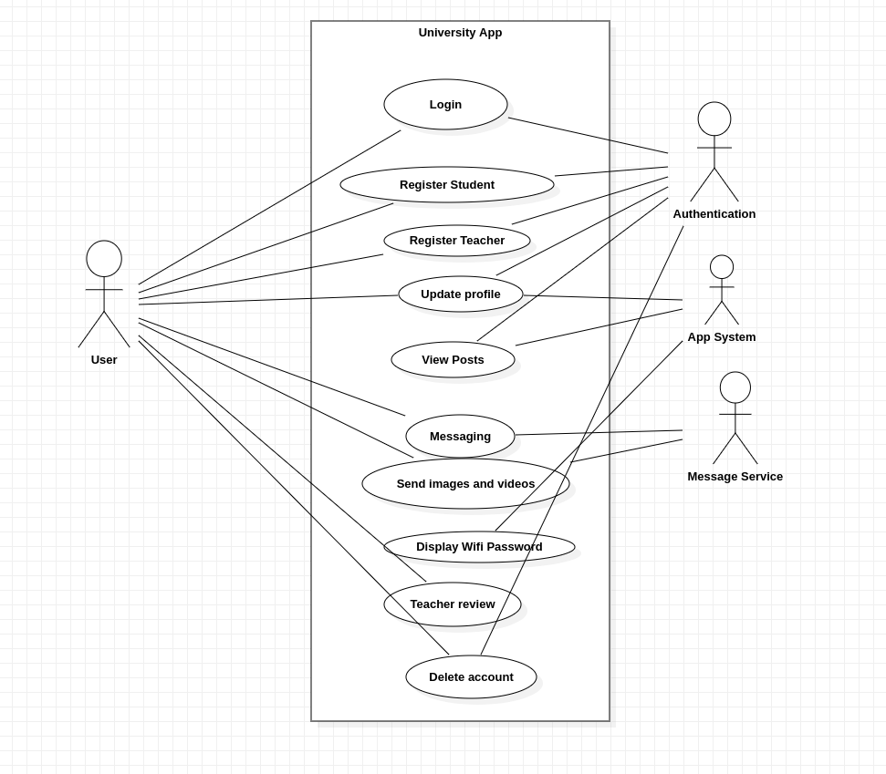
Use Case Diagram

Slide 12
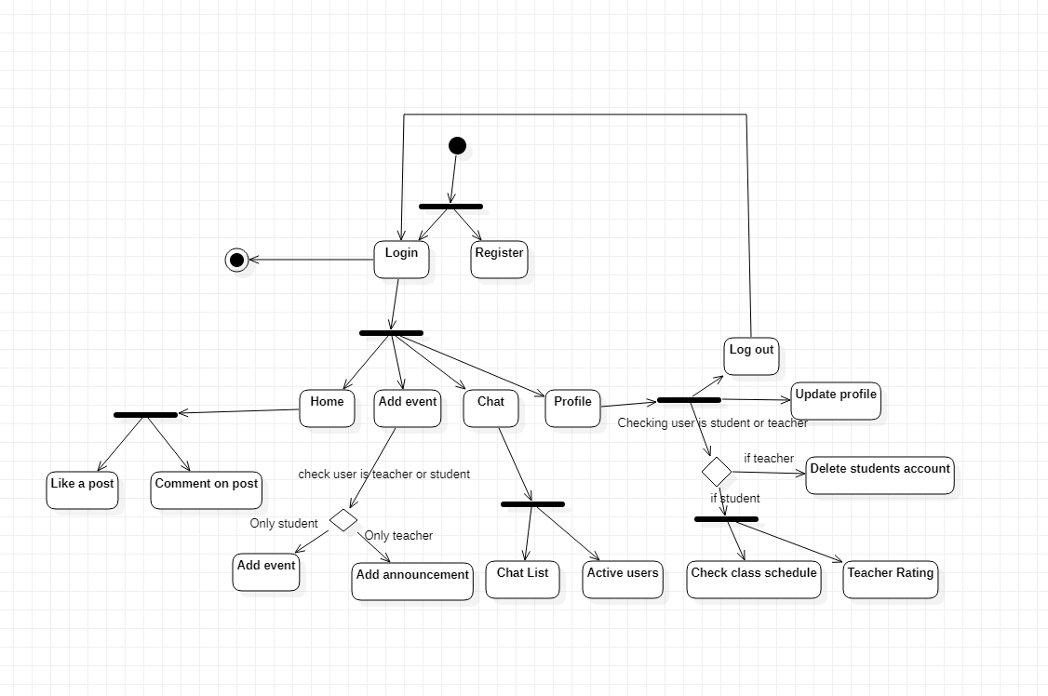
Activity Diagram

Slide 13
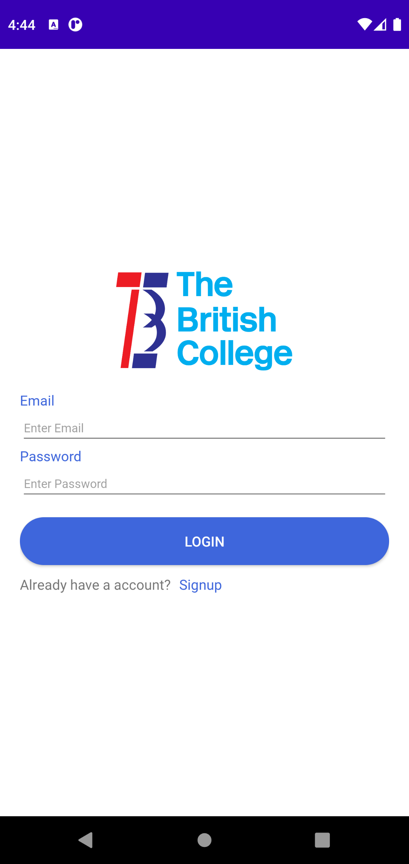
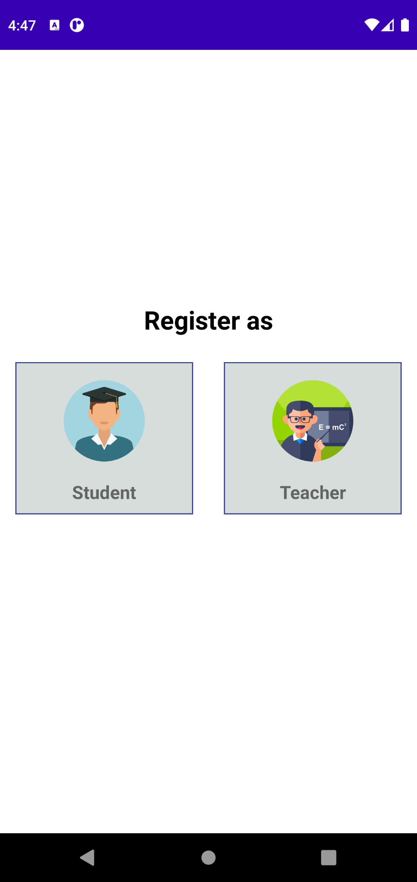
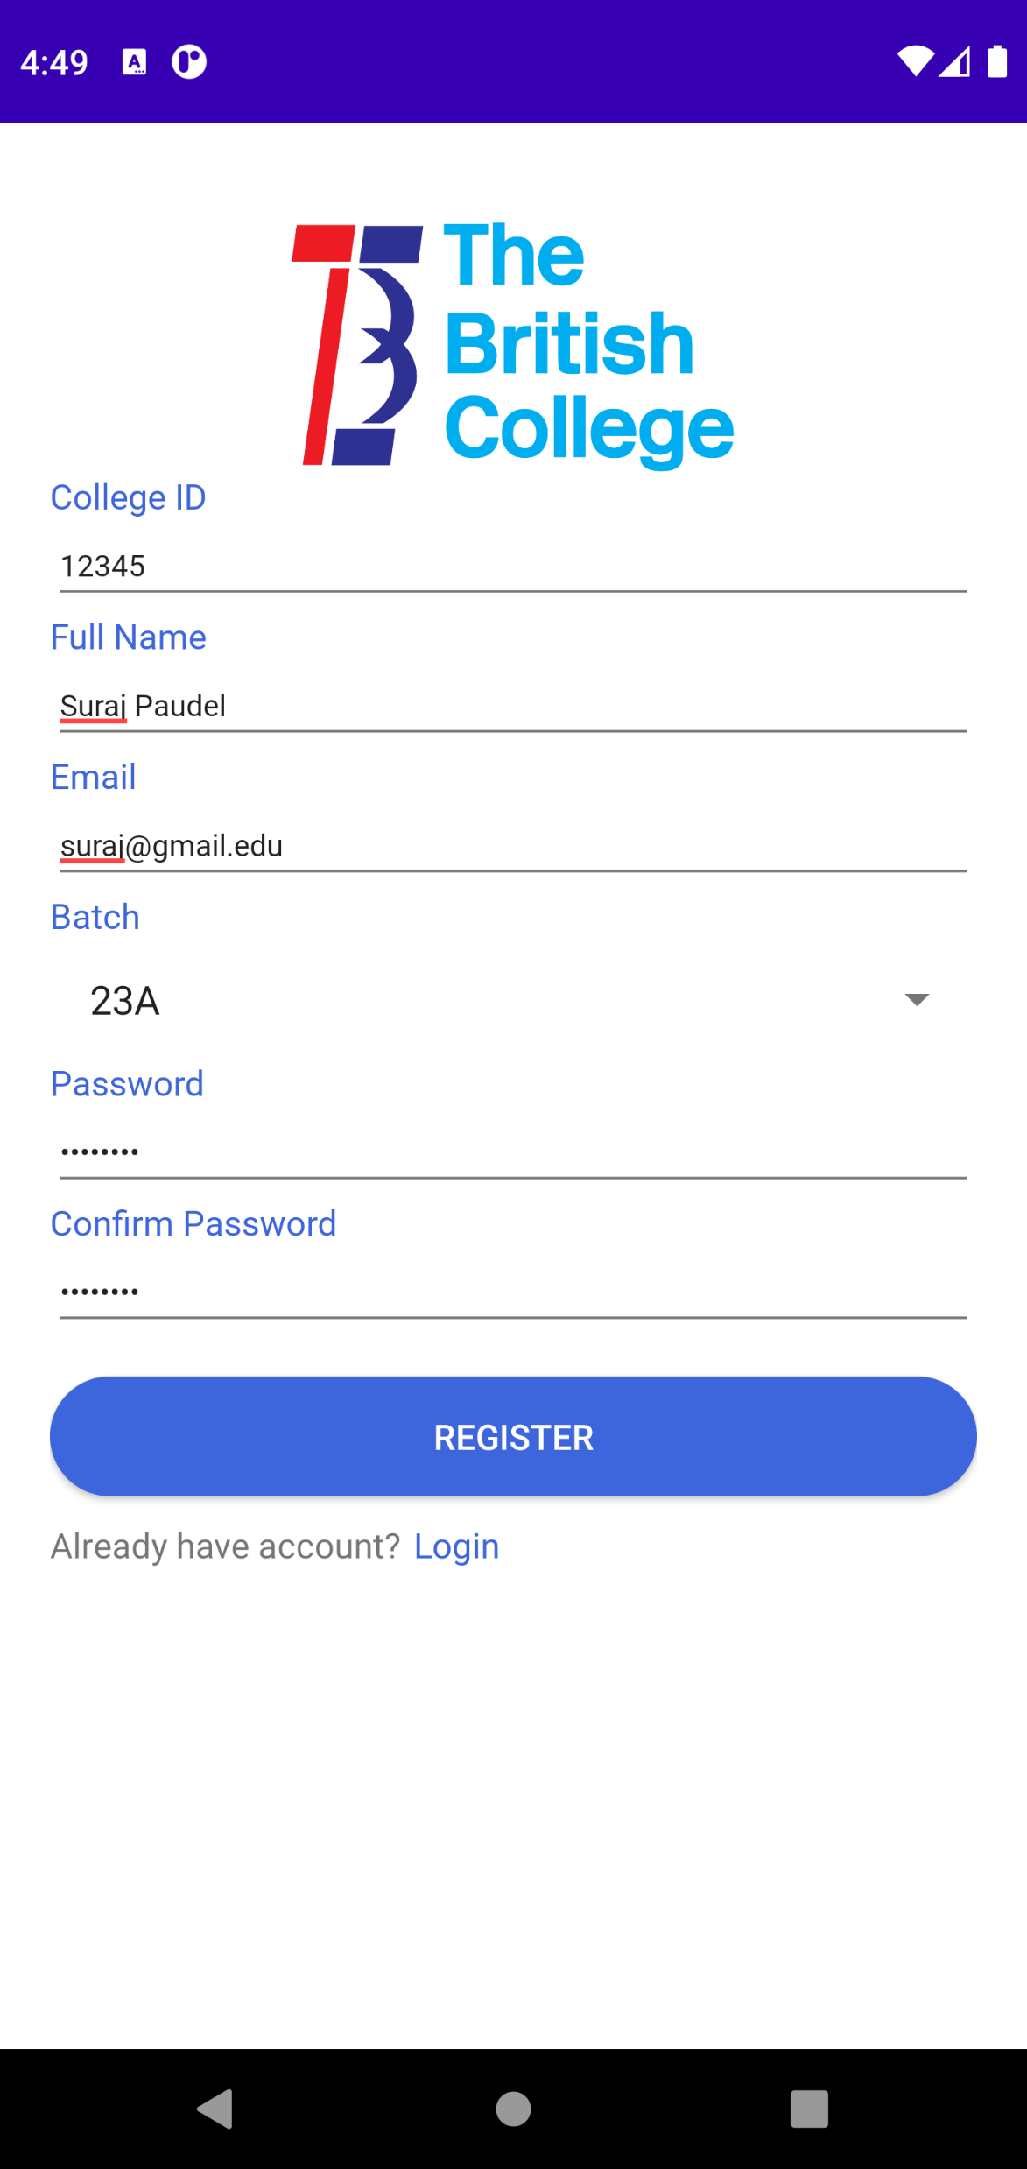
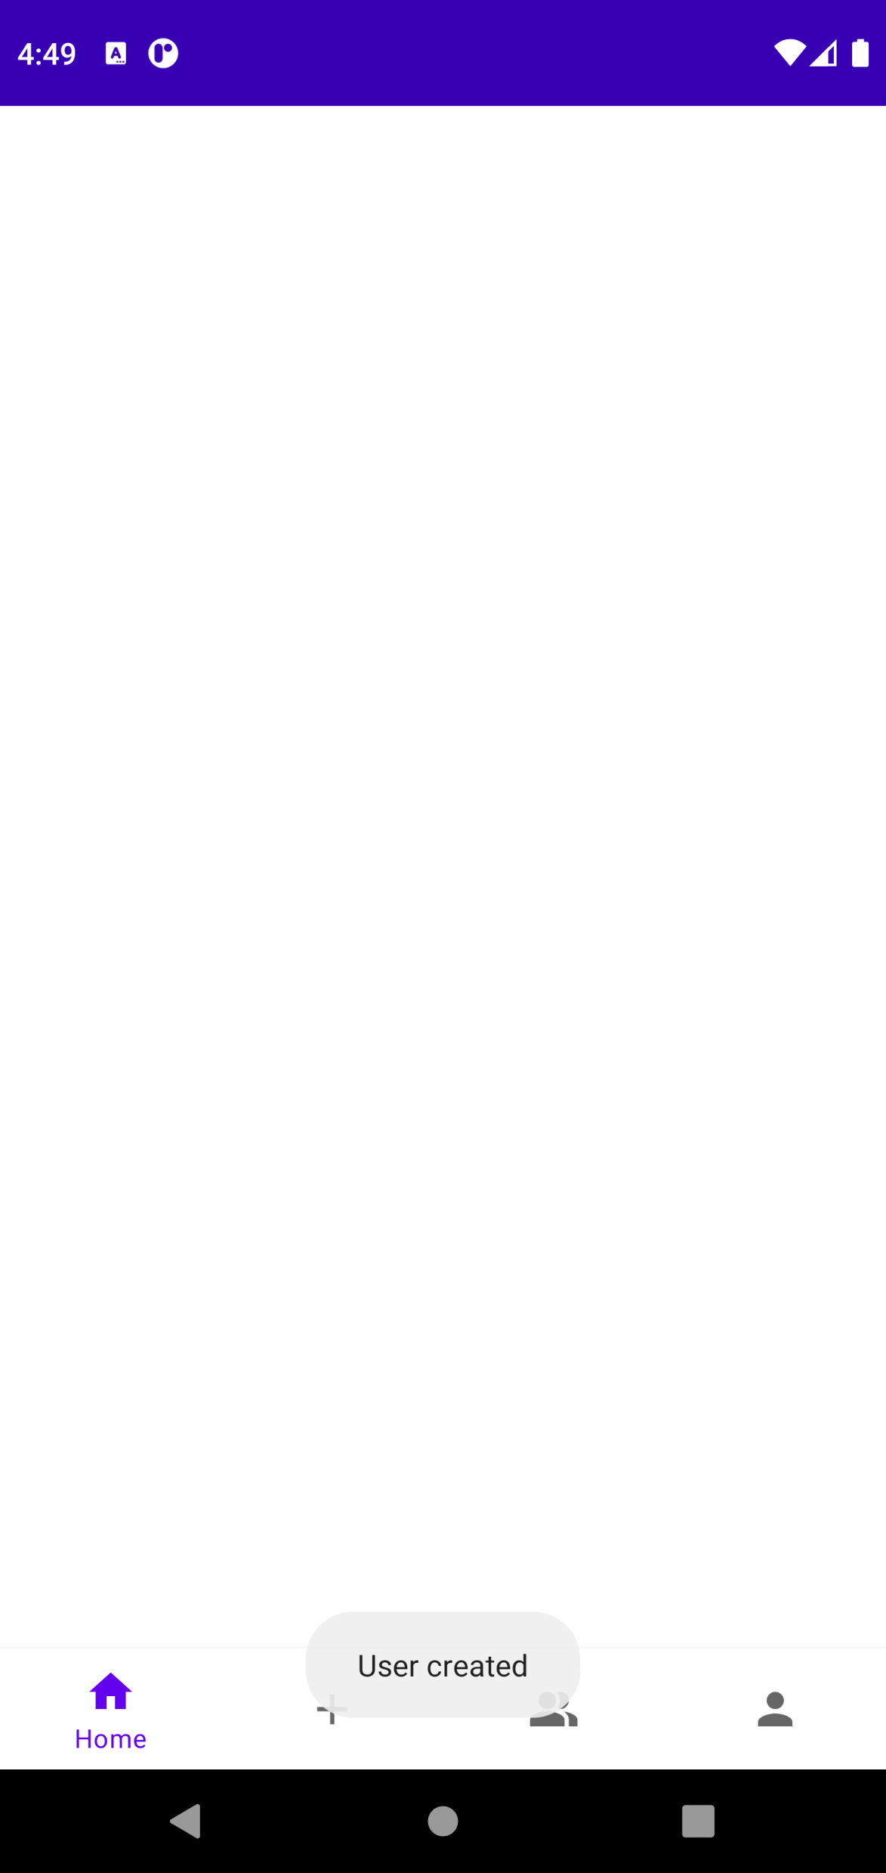
Student’s Manual
Login Page
Register Page
Student’s Register Page
Student User Created

Slide 14
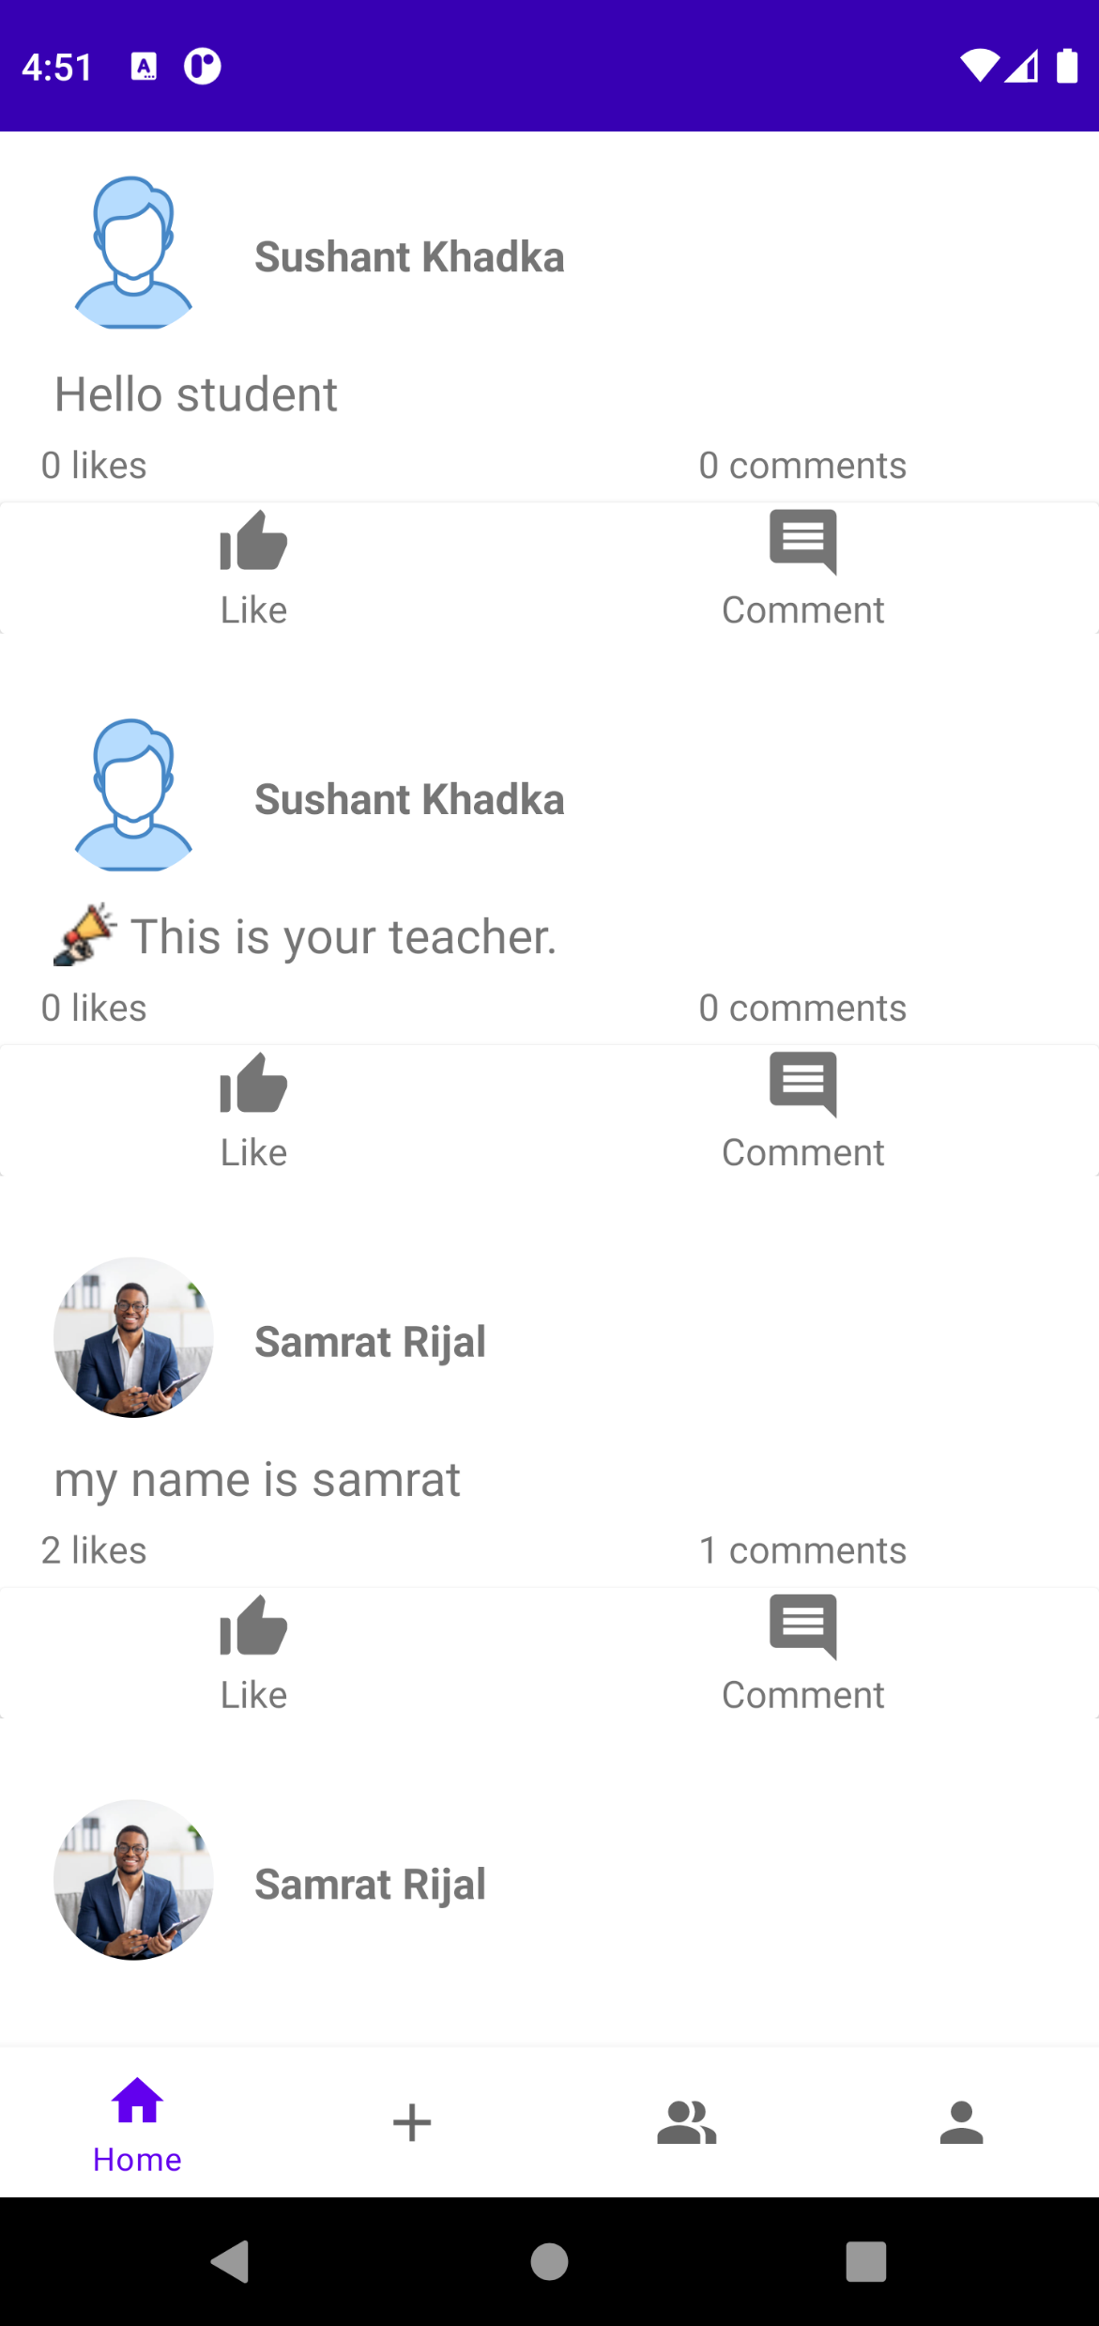
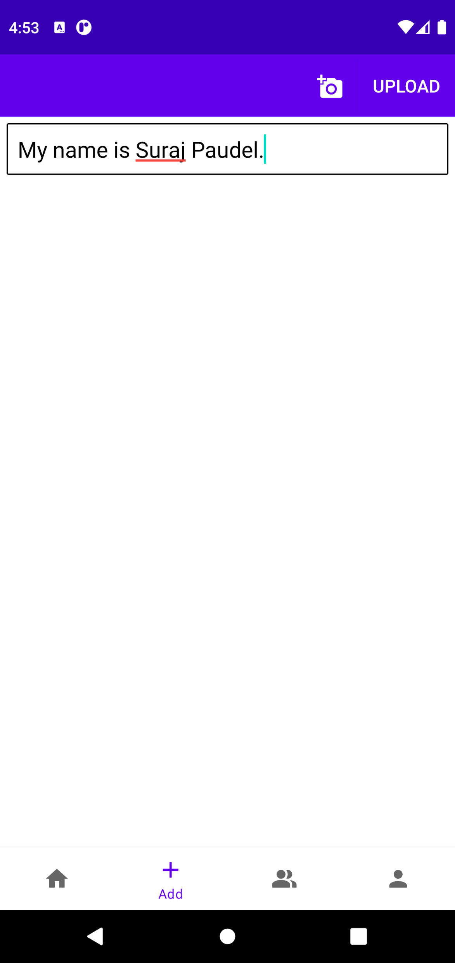
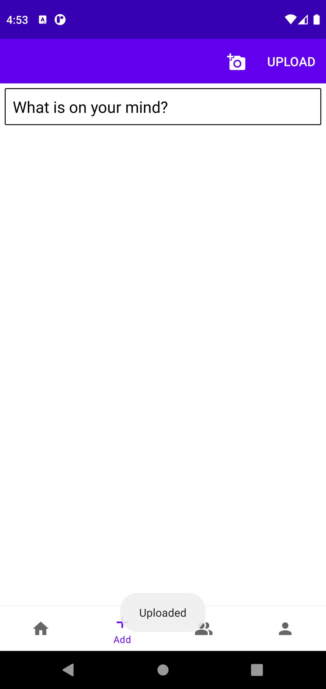
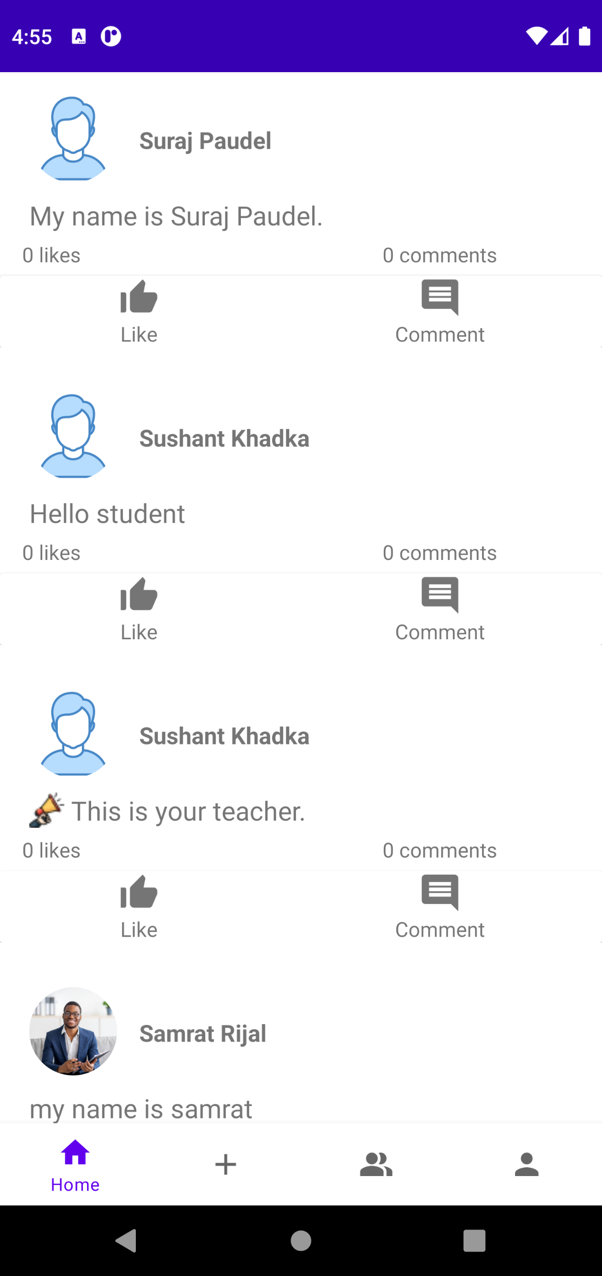
Home Feed
Post Upload
Post Uploaded Successfully
Uploaded Post on Home Feed

Slide 15
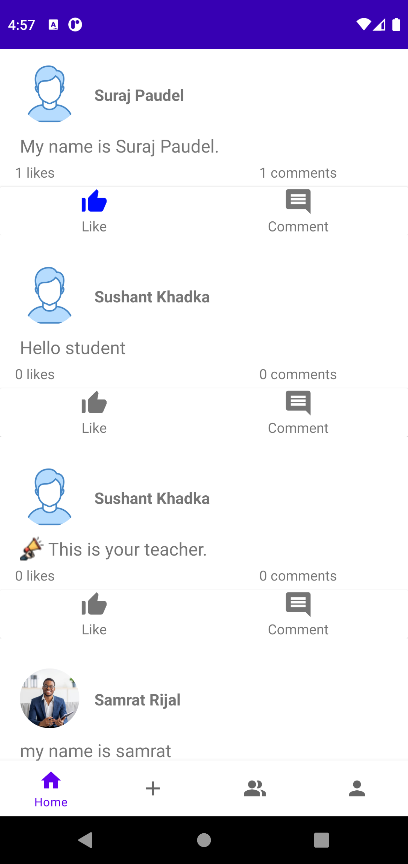
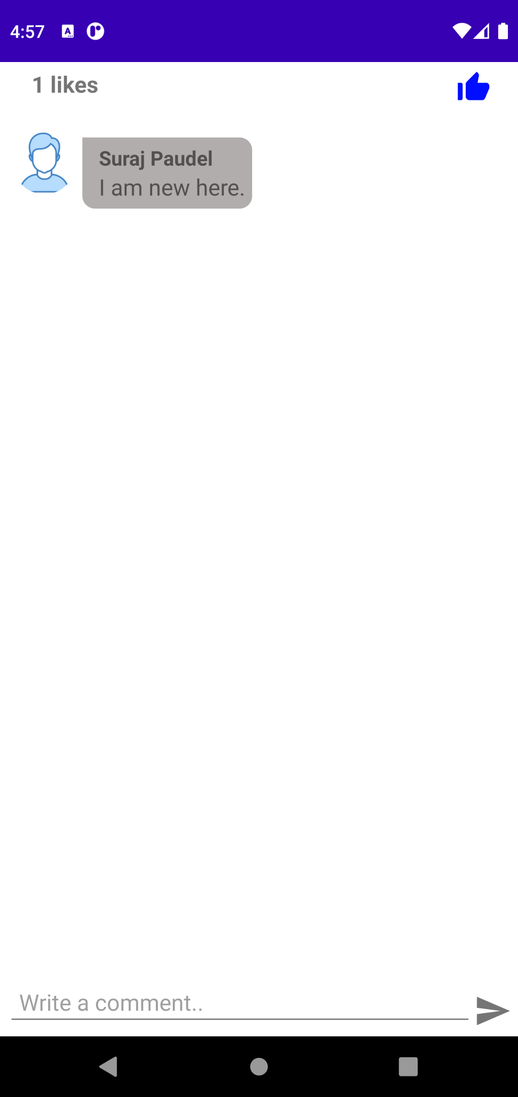
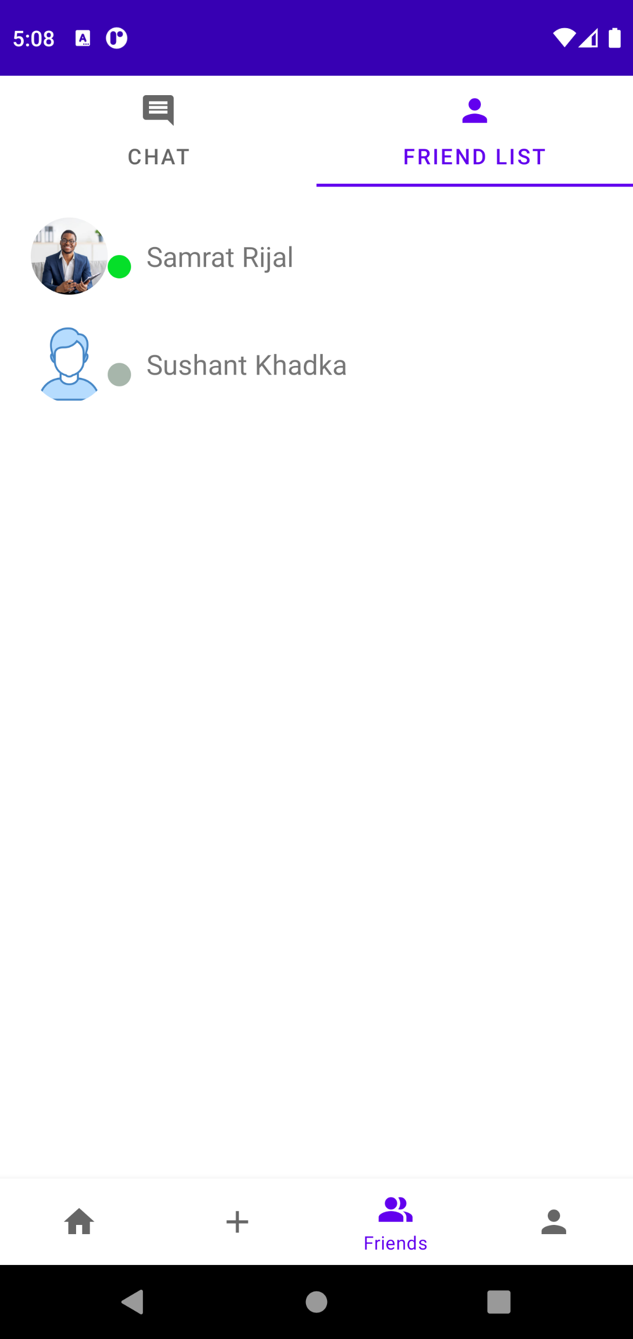
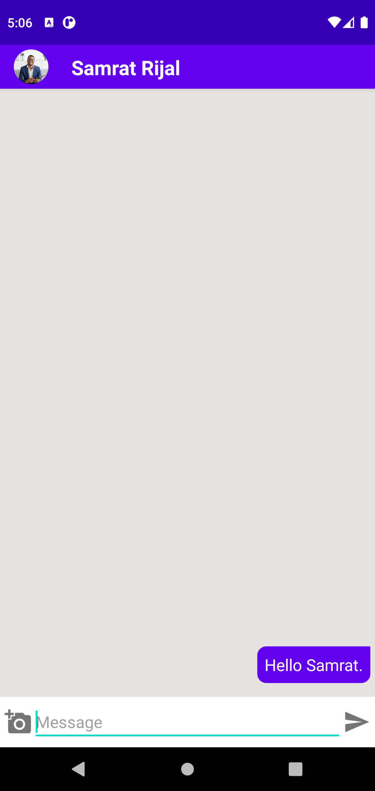
Like Post
Comment Post
Friend List
Message Sent

Slide 16
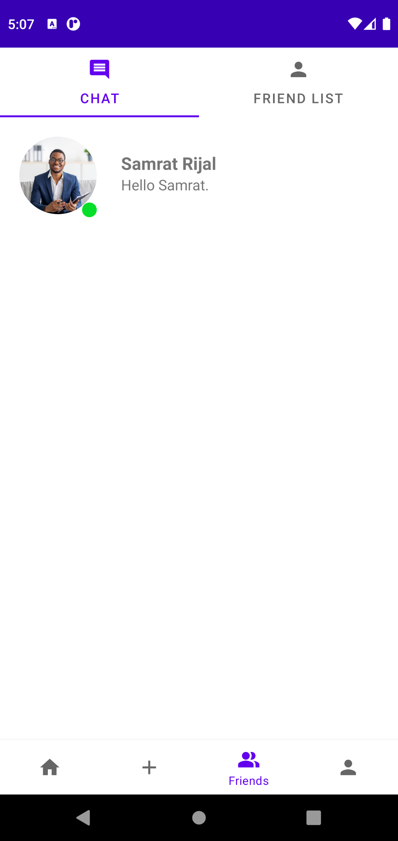
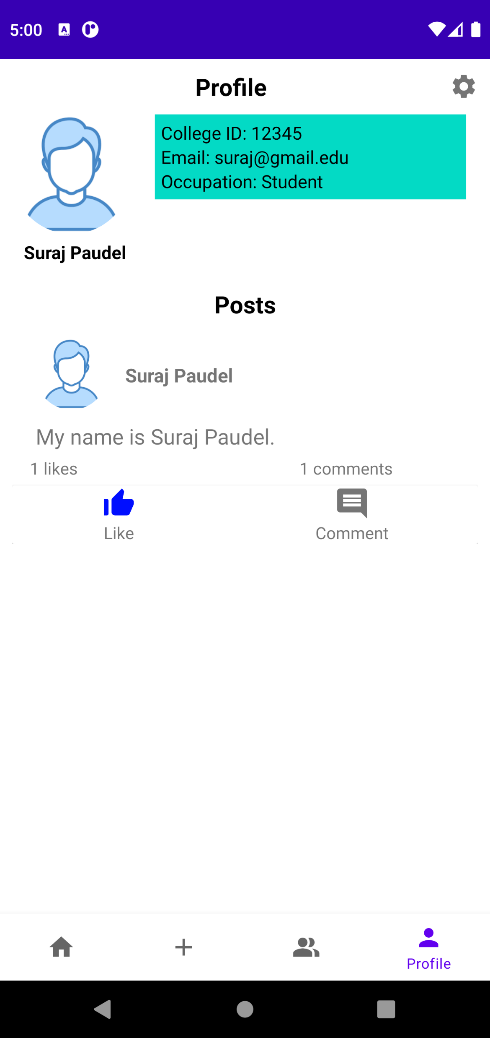
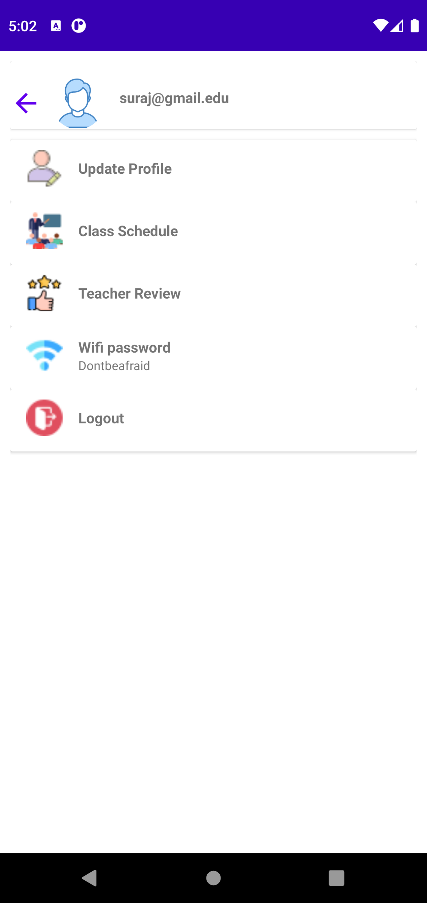
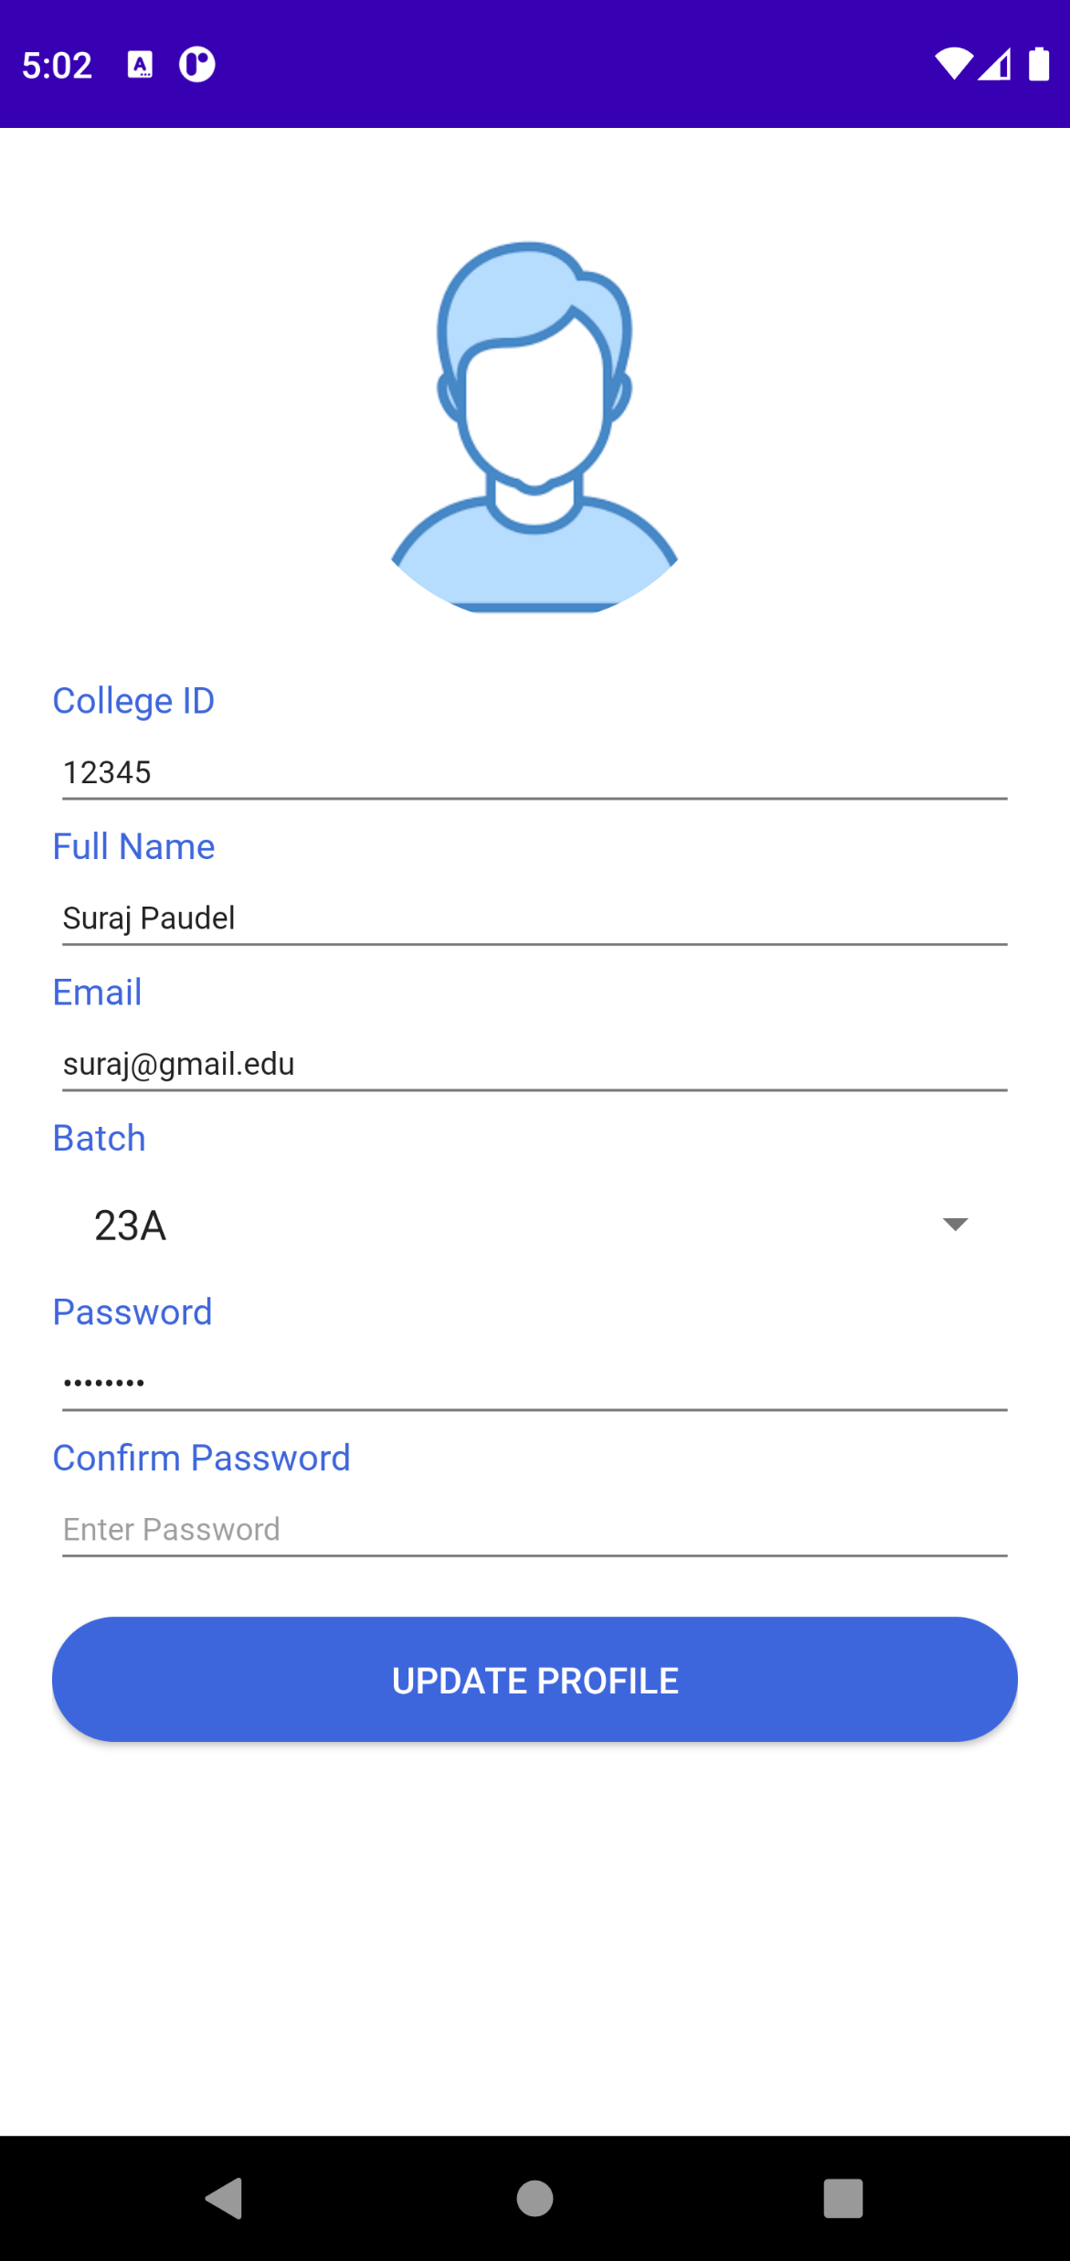
Chat Box
Student’s Profile & Posts
Settings
Update Profile

Slide 17
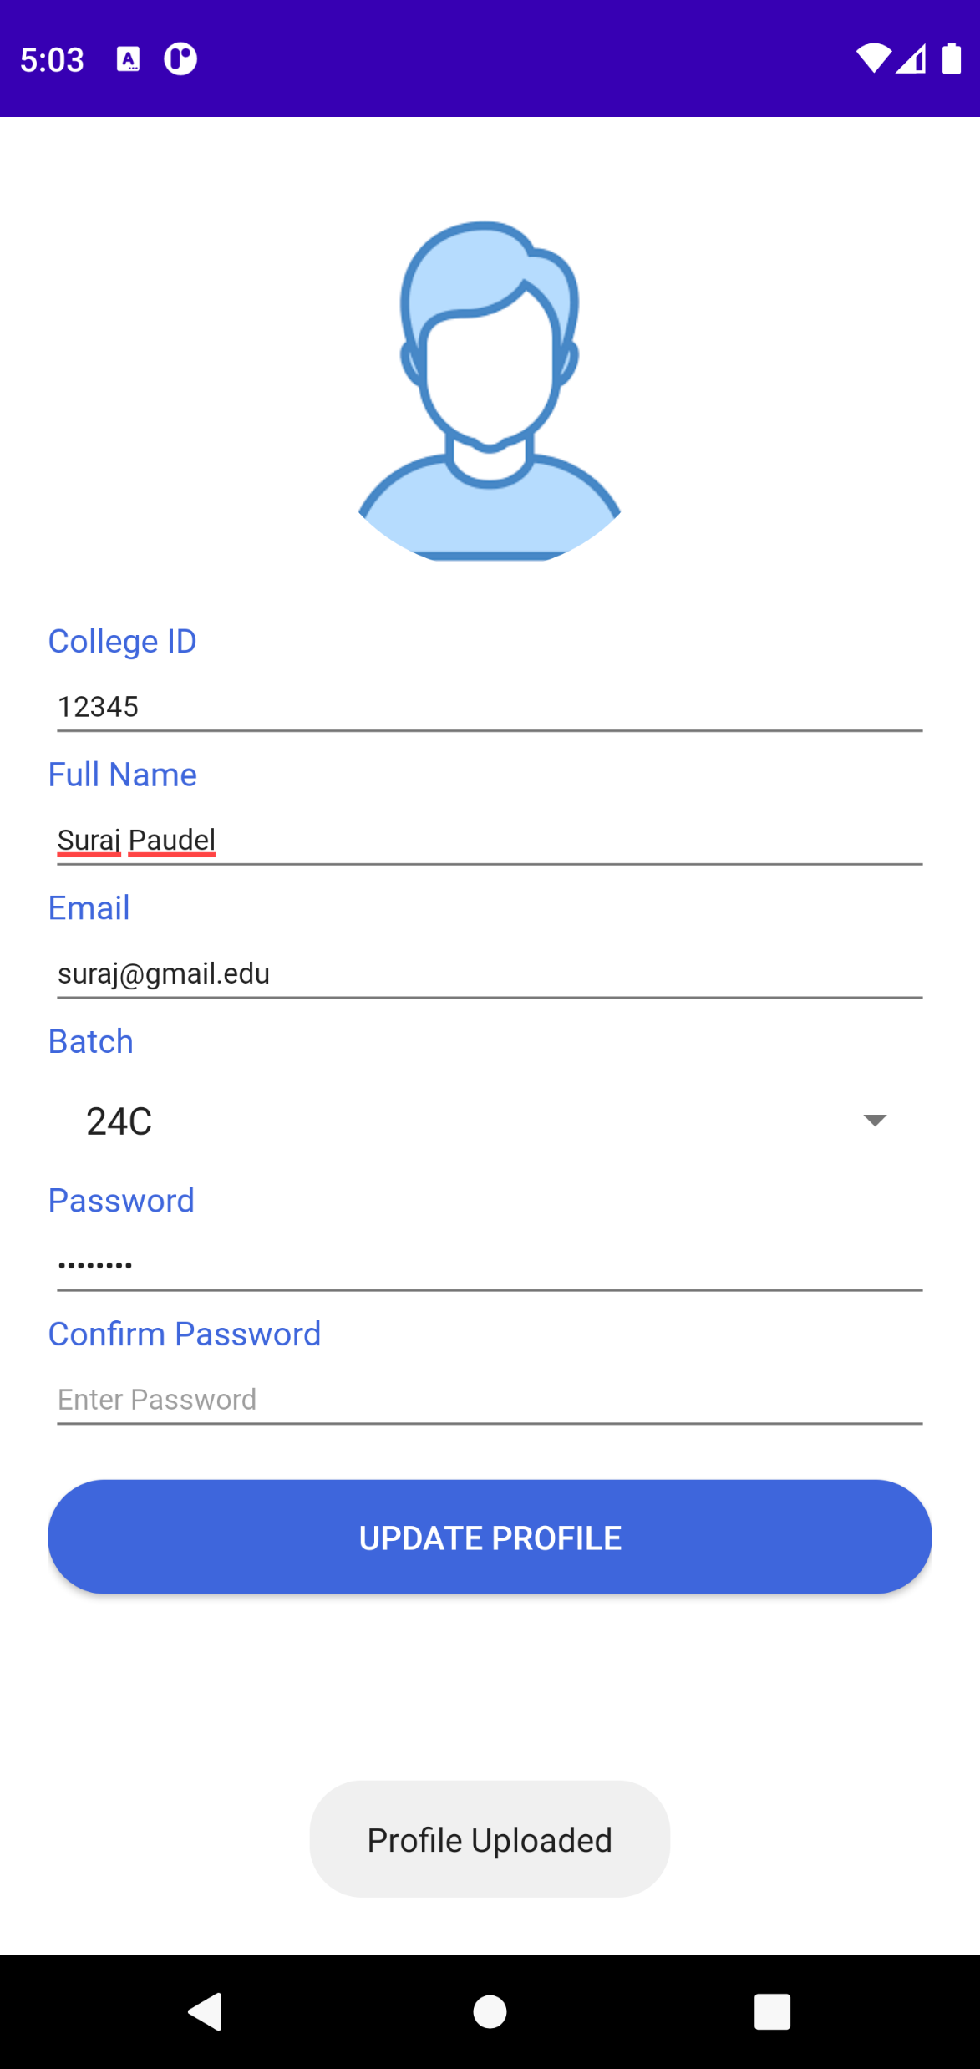
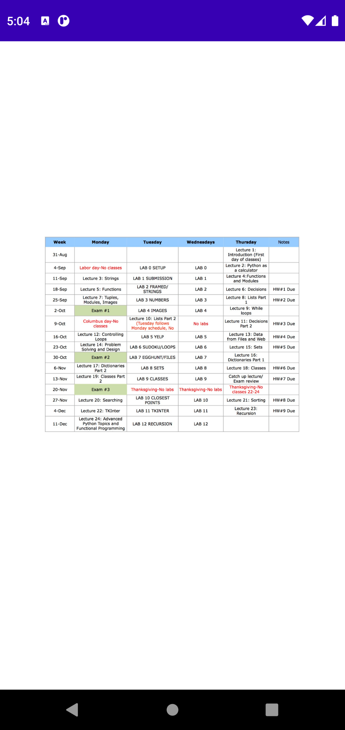
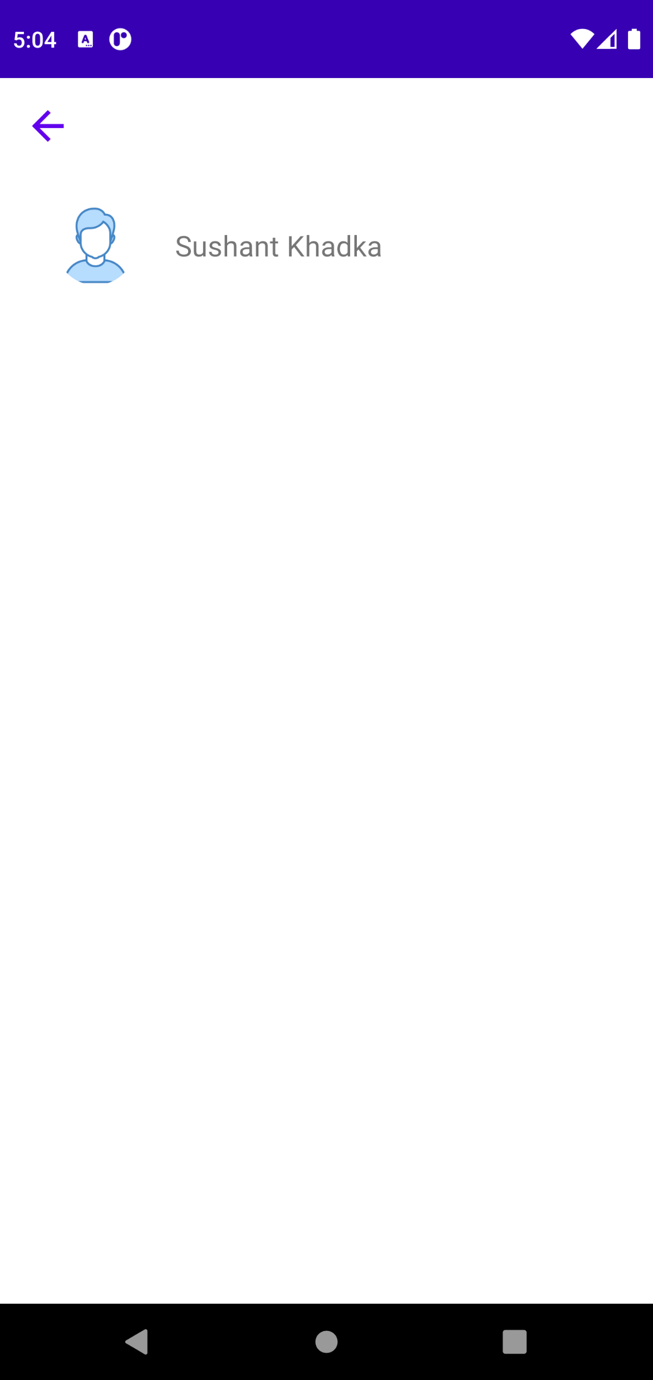
Profile Update Successfully
Class Schedule
Teacher Review

Slide 18
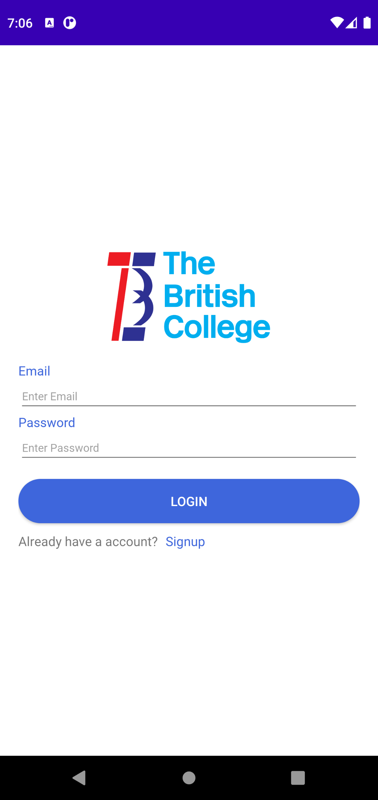

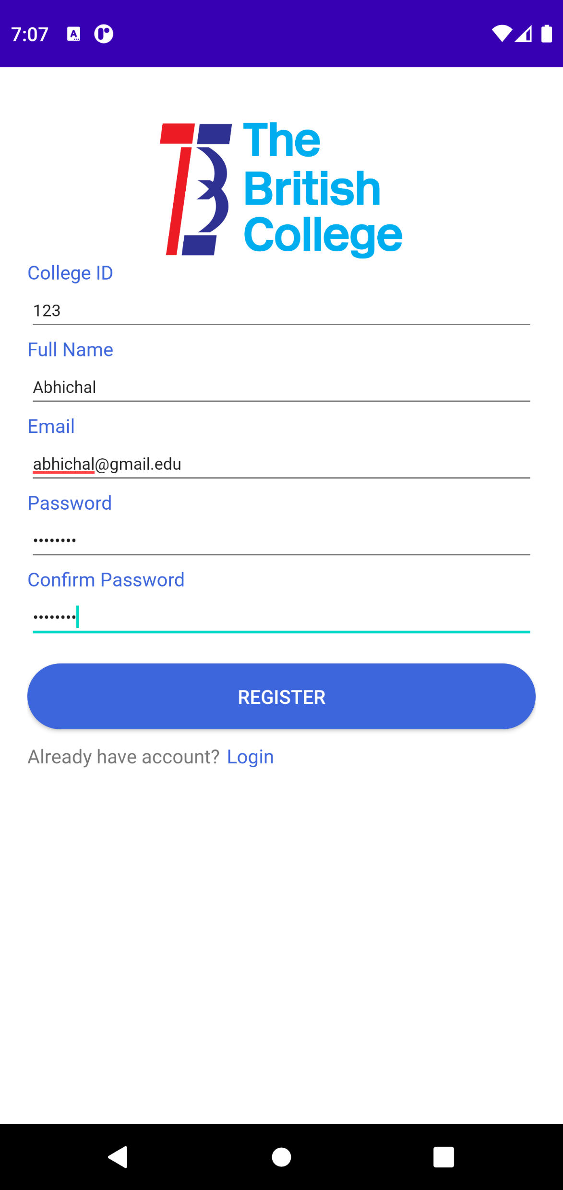
Teacher’s Manual
Login Page
Register Page
Teacher’s Register Page

Slide 19
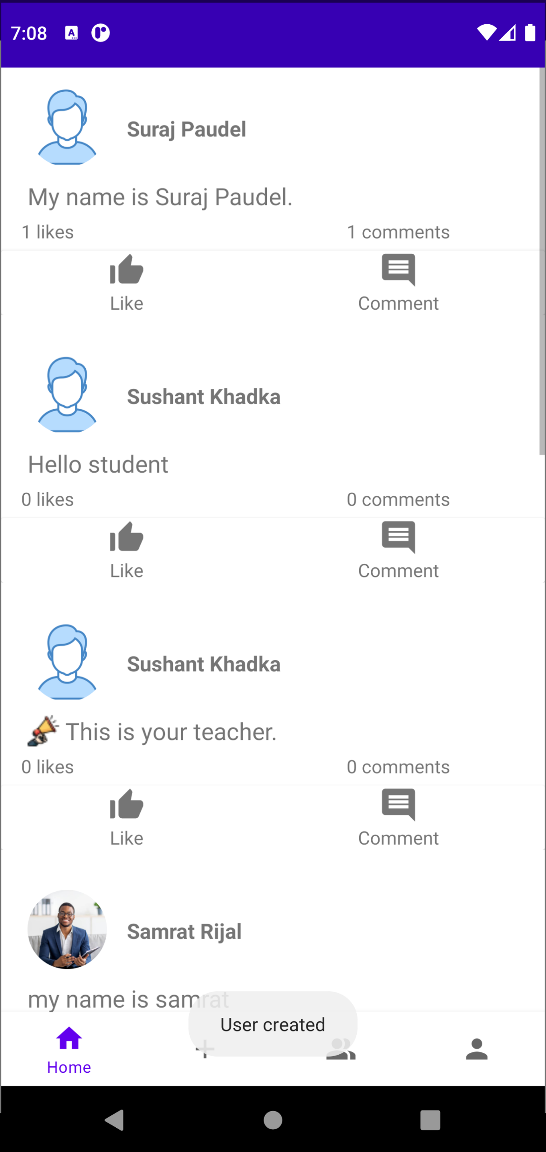
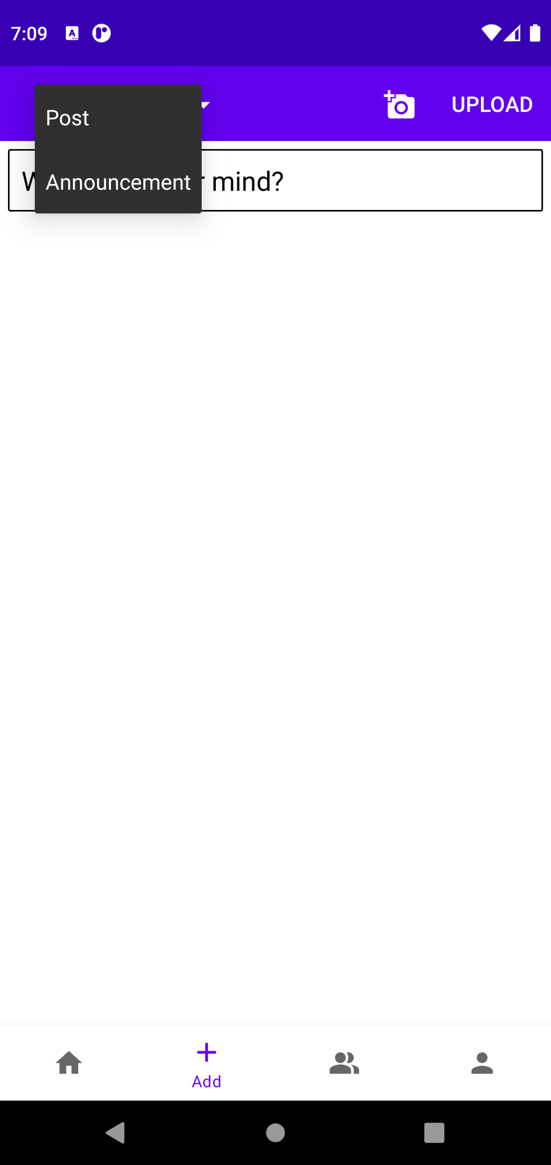

Teacher user created
Post/Announcement
Announcement Upload

Slide 20

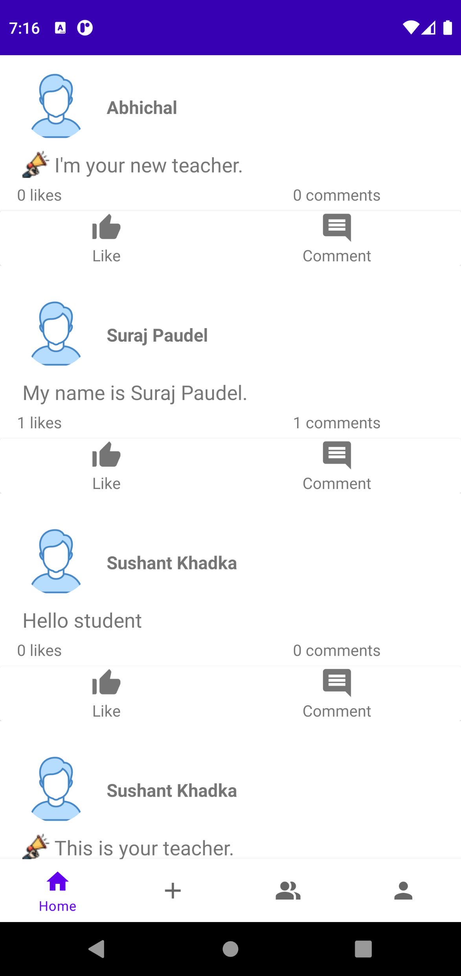
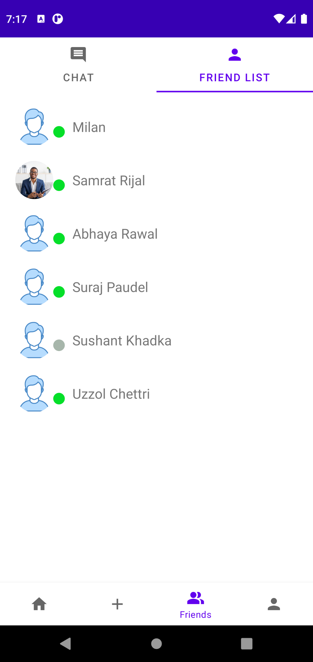
Announcement Uploaded Successfully
Announcement on Home feed
Student List

Slide 21
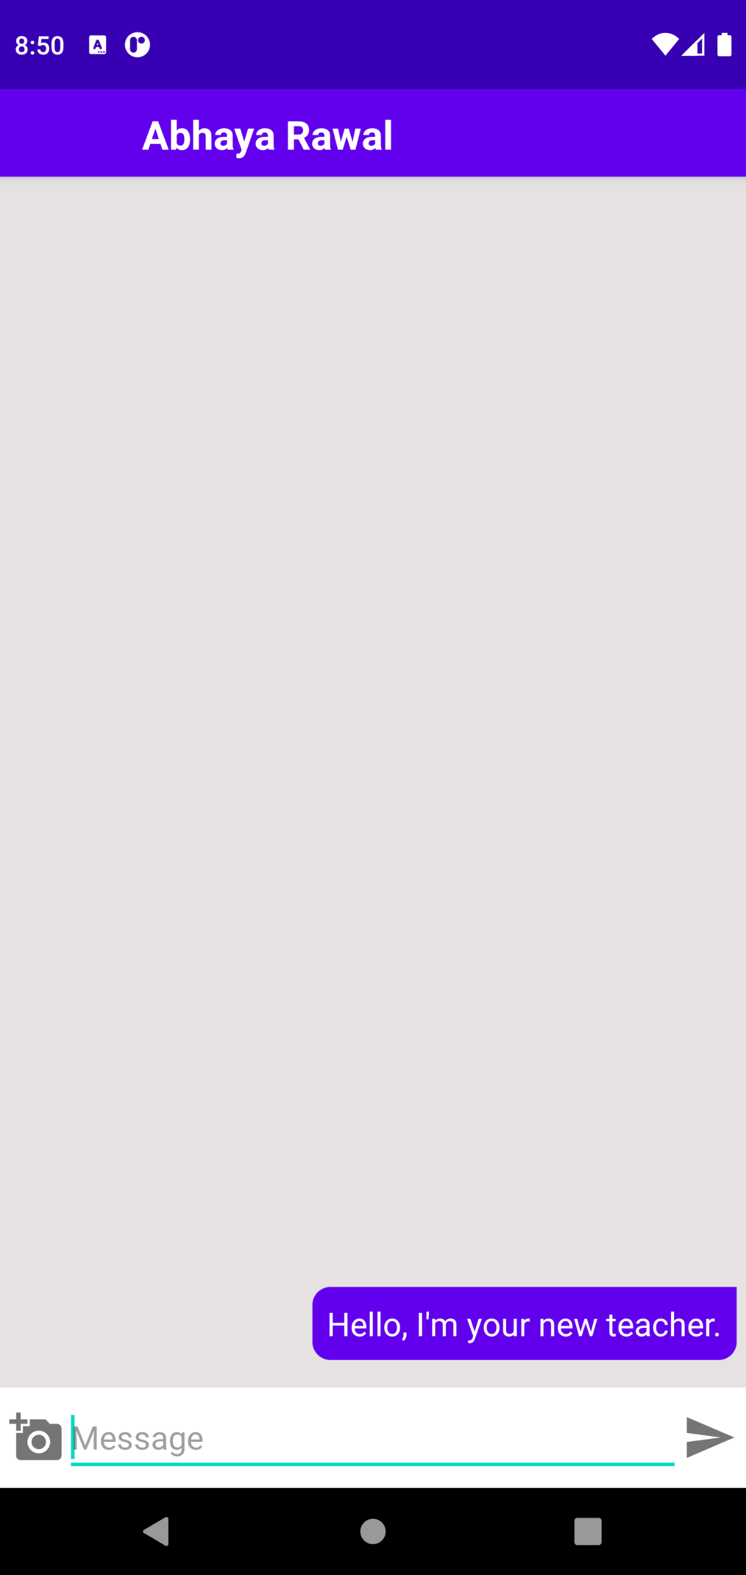
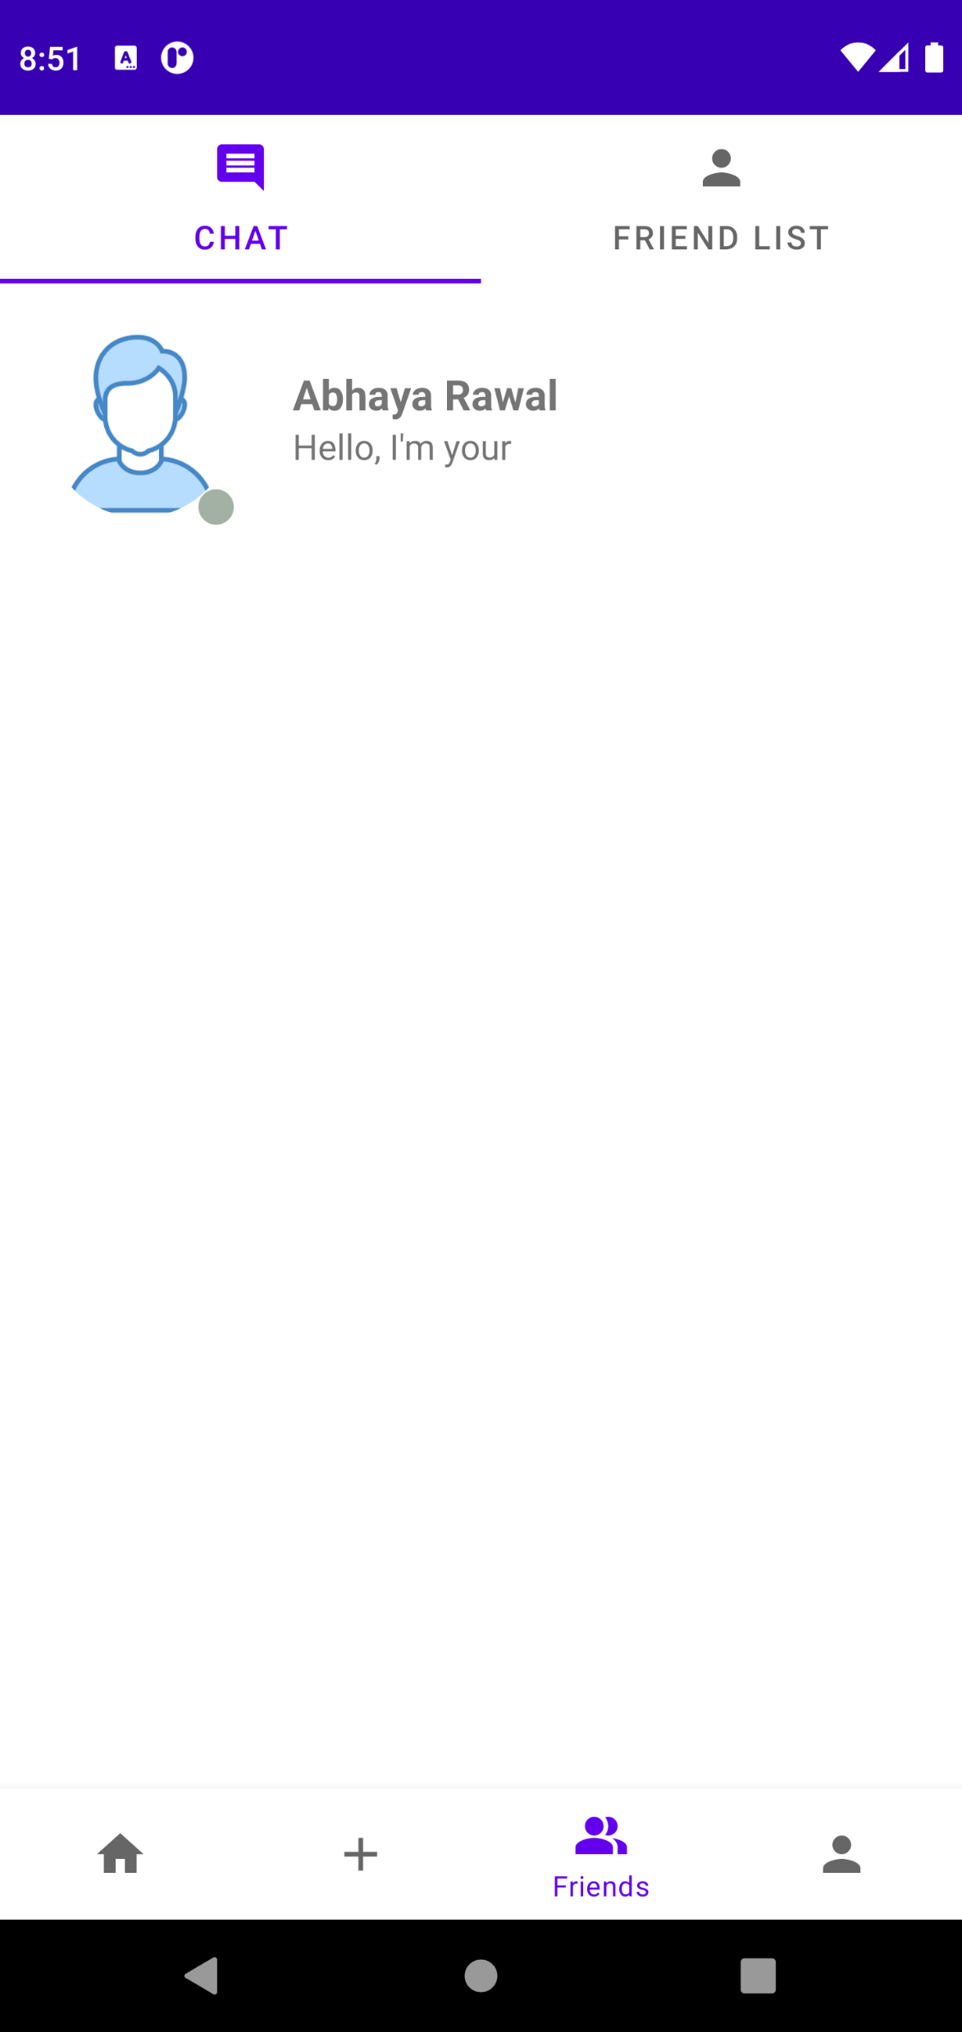
Message Sent
Chat Box

Slide 22
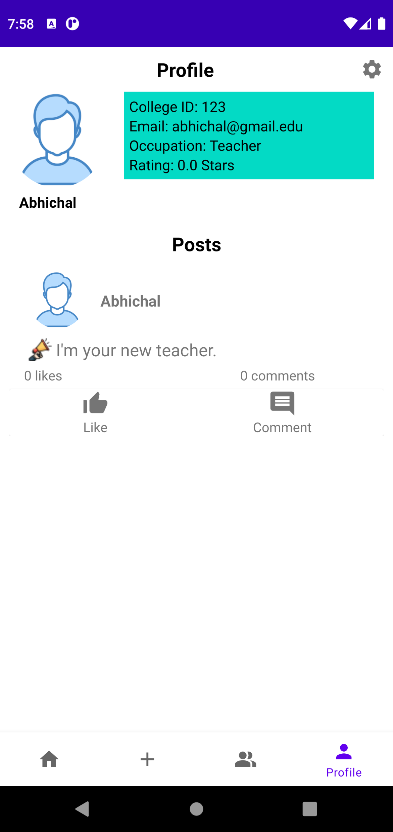
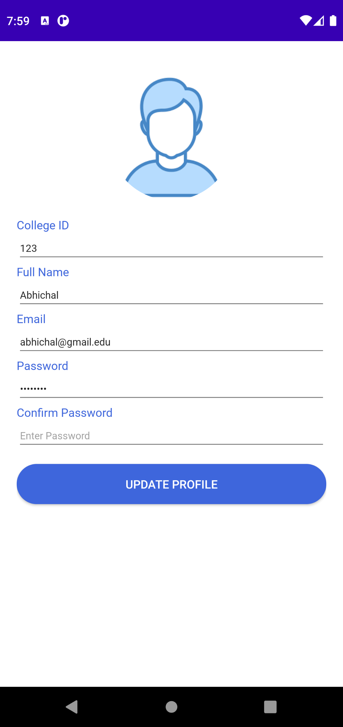
Teacher’s Profile and Posts
Update Profile

Slide 23
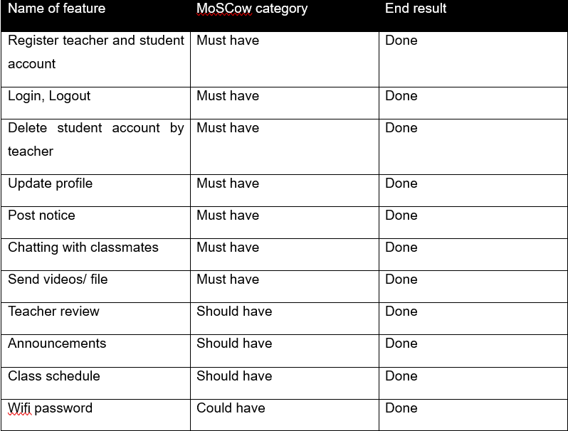
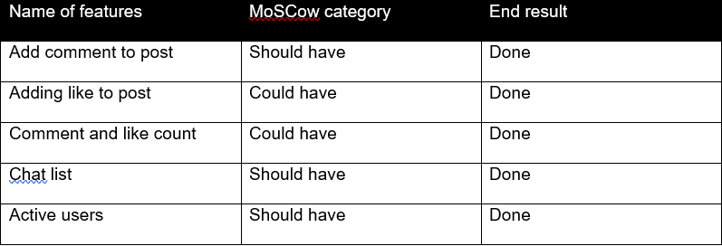
Product Evaluation

Slide 24
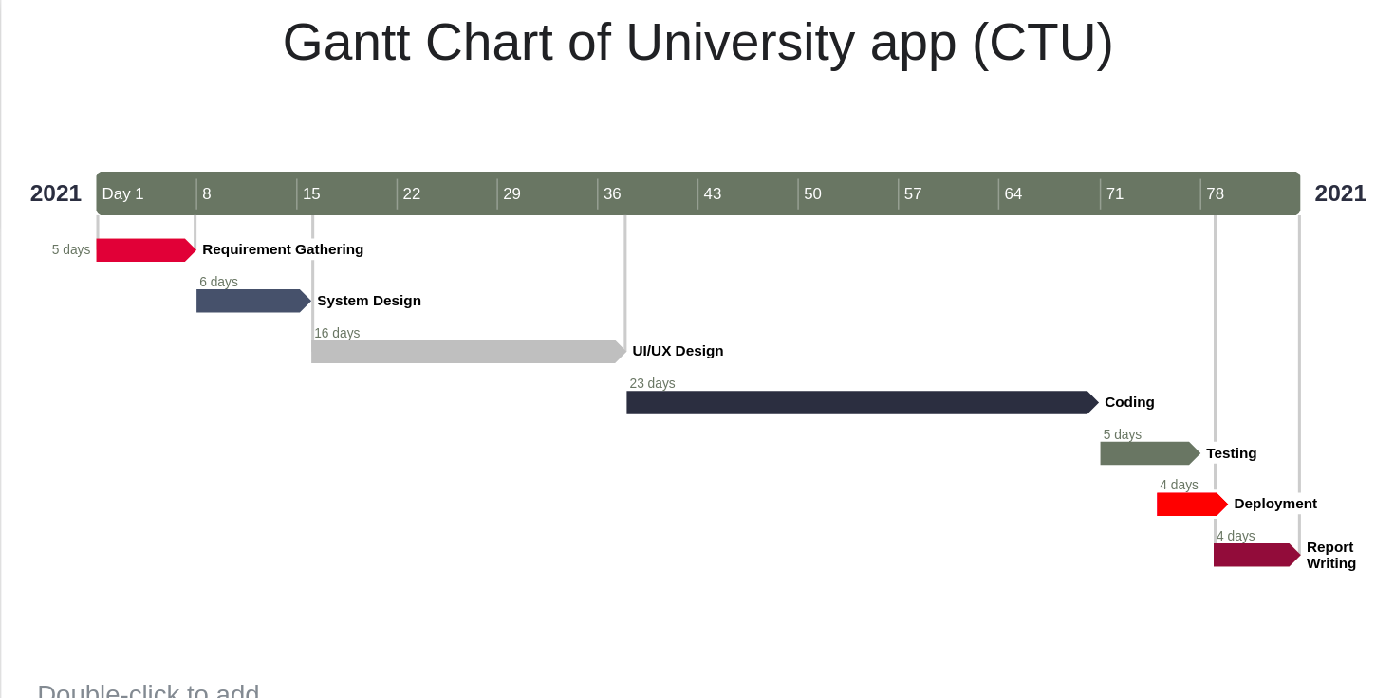
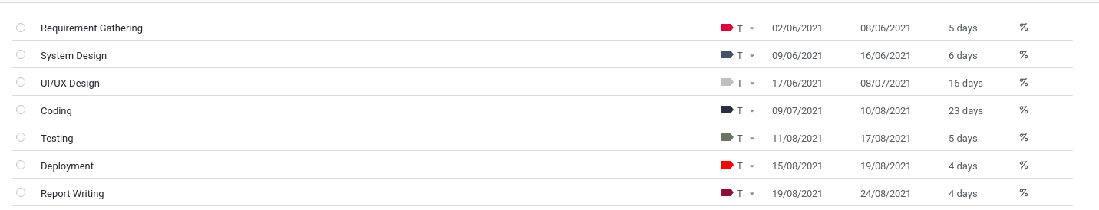
Project Evaluation

Slide 25
Conclusion
The goal of this study was to improve university-student communication.
The FIFO mechanism and talking system with the teacher were some of the new ideas gained through further study to make the application more user-friendly.
That notice can now reach every university student in seconds was my personal achievement. The extra classes, public holidays, and other academic announcements will not be missed.
As a result, the university application was created, meeting all standards.

